Slide 1
Chemistry Review: Lipids
Lecture 5

Slide 2
Objectives 1 of 2
Know names of 3 lipid classes, their function and purpose
Know the structure of the fatty acid & its chemistry and meaning of examples like C16:0 and C18:1
What is an unsaturated and saturated fatty acid and how does it affect cell membrane fluidity
What triglycerides are and role of glycerol
What a phospholipid is: structure & function in cell membrane bilayer
What is a micelle and liposome
What cholesterol does in animal cell membranes

Slide 3
Objectives 2 of 2
Lipoproteins: types (chylomicron, VLDL, …, HDL), structure & function/role in lipid metabolism, concept of density
What atherosclerosis is and the theory on how it occurs

Slide 4
Lipids ("Fats")
Lipid classes
Triglycerides: storage lipids
a nonpolar lipid used as "food"
catabolized to yield calories for ATP for other processes
Phospholipids
a polar lipid which is the "skeleton" of cell membranes
Glycolipids
another polar lipid with special properties
Steroids
help in membrane rigidity
many hormones derived
Other lipids: terpenes, used to make vitamins

Slide 5
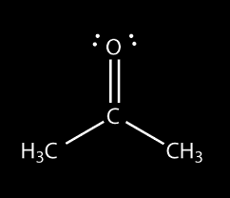
Terms / Definitions
Lipophilic ("fat-loving") and Hydrophobic ("water-fearing) generally have the same meaning
Lipids are insoluble in H₂O
"oil and water do not mix"
Lipids readily are soluble (dissolve in) organic solvents
alcohol (ethanol, CH₃CH₂OH, EtOH)
ether (diethyl ether, CH₃CH₂–O–CH₂CH₃)
acetone (2-propanone)

Slide 6
The Fatty Acid (FA)
Two parts in the chemical structure
a long alkyl (–CH₂–) chain that is hydrophobic (lipophilic): doesn't interact with H₂O
an acidic moiety that forms a negative (anionic) charge in water
Structure is: CH₃(CH₂)_{n}COOH for the saturated fatty acids
Saturated vs. Unsaturated Fatty Acids
Saturated means that all the hydrogen (H) atoms that can possibly bond to carbon (C) atom do bond
Unsaturated means that not all the possible H atom bonding is done to carbon, and this is indicated by double bonds between carbon atoms (C=C)

Slide 7
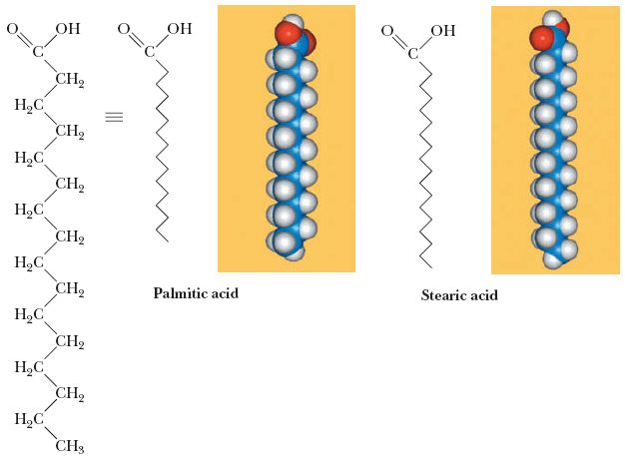
Saturated Fatty Acids
C16:0 Palmitic acid
C18:0 Stearic acid
C12:0 Lauric Acid C14:0 Myristic Acid
C16:0 means
total of 16 carbons
0 double bonds

Slide 8
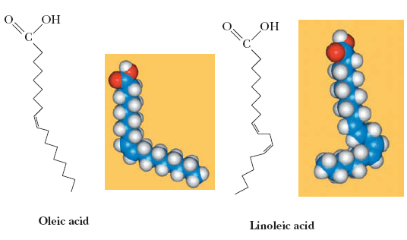
Unsaturated Fatty Acids
C16:1 Δ⁹ Palmitioleic acid
C18:1 Δ⁹ Oleic acid
C18:2 Δ^{9,12} Linoleic Acid
C18:3 Δ^{9,12,15} α-Linoleic Acid
C20:4 Δ^{5,8,11,14} Arachidonic Acid
Δ⁹ means a double bond starts at carbon #9
With more than one C=C (carbon-carbon double bond), there is a single intervening carbon not involved in the double bond

Slide 9
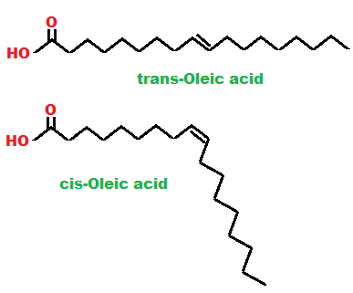
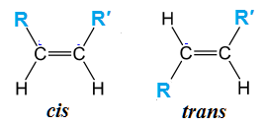
C=C Double Bonds: cis vs trans
Carbon-carbon double bonds can have two possible geometries
cis: the carbon chain continues on the "same side" of the double bond
trans: the carbon chain continues on the "opposite side" of the double bond
In fatty acids, the C=C bond(s) is/are cis
the cis double bond can make the FA have a "kink" to it

Slide 10
Saturated vs Unsaturated
With saturated FAs (and also with "trans-" unsaturated FAs), these molecules can pack tightly together
At low temperatures, they pack so well, they can form a solid (grease)
But with cis-unsaturated FAs in the mix, they don't pack to so well
At low temperatures, they keep the mixture liquid: an oil
Plants generally make more unsaturated FAs for their lipids used in cell membranes to keep them fluid, because they don't have "body heat" like animals

Slide 11
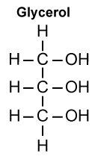
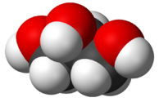
Glycerol
A 3-carbon polyhydroxy (poly-OH) alcohol that is fundamental in lipids important in biology
In organic chemistry, an alcohol has the structure R-OH
Glycerol has 3 R-OH groups
Glycerol is found as an intermediate in many metabolic pathways, particularly in lipid metabolism (catabolism and biosynthesis)
On the following slide, it is shown why glycerol was introduced

Slide 12

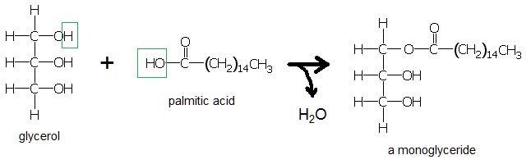
The Fatty Acid Ester
In organic chemistry, the condensation of a carboxylic acid with an alcohol produces an ester
Condensation is the opposite of hydrolysis: H₂O is taken out
A fatty acid (like palmitic acid) is a carboxylic acid
Glycerol is an alcohol (has 3 –OH groups)
Thus it forms an ester

Slide 13


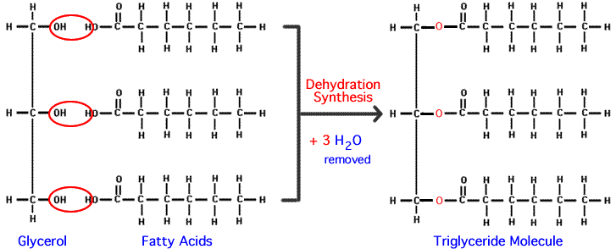
Triglyceride Formation
Now, repeat the process of esterifying two more fatty acids to the other two –OH groups on glycerol and … you have a triglyceride

Slide 14
Triglycerides Role/Function
These lipids are generally the storage form of fats for energy in metabolism
They will be stored in cells of adipose tissue until mobilized in catabolic pathways

Slide 15
Polar Lipids
Polar lipids means one part is polar: hydrophilic, prefers being around H₂O
These would be molecules whose parts have –OH groups (especially large molecules like carbohydrates) or have charged groups –COO–, –NH₃⁺
Phospholipids and glycolipids are among the major polar lipids
Cholesterol has minor polarity

Slide 16
Phospholipids
These differ from triglycerides (TGs) in that only two fatty acids are esterified to glycerol
The other glycerol –OH is esterifed to a phosphate molecule (–OPO₃)
Because the phosphate is negatively charged, if only a phosphate is on the molecule, the phospholipid will be negatively charged

Slide 17
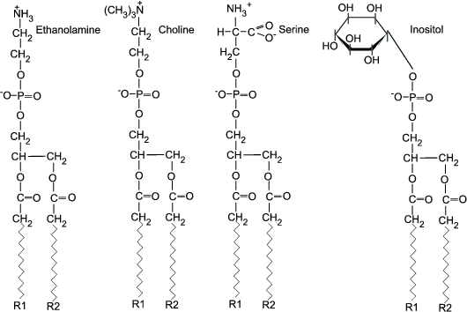
Other Phospholipid Types
But in fact, other groups are added to the –OPO₂– group that is already attached to glycerol
These are serine, choline, ethanolamine, inositol
Ethanolamine and choline mask the phosphate negative charge and puts a positive charge at the end
The serine still leaves a net negative charge, as does the inositol form. The inositol form is important precursor in calcium-regulated cell activation

Slide 18
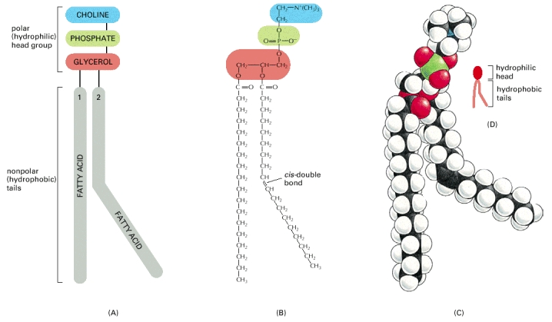
Phosphatidylcholine
The figure below shows the phospholip phosphatidylcholine in three ways: schematic, chemical structure, and a space-filling model
Notice how the cis-fatty acid would make it difficult for the membrane to pack tightly, giving it fluidity

Slide 19
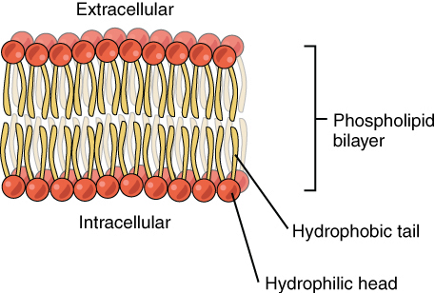
Phospholipid Bilayer
The ability of the phosholipids to associate in opposite facing sheets (bilayer) makes them a natural chemical to form lipophilic membranes that compartmentalize aqueous solutions

Slide 20
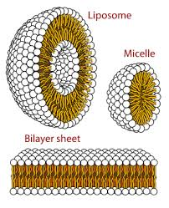
Micelles & Liposomes
Polar lipids (including phospholipids) can form micelles: spheres in which the hydrophobic tails are directed towards the center and the polar heads are oriented to the surface to make contact with water
Liposomes are spheres where the phospholipid bilayer sheet forms a sphere with an interior that is composed of the outer solution during liposome formation
Liposomes can be formed by ultrasonication with a phospholipid solution containing a drug or useful toxicant, along with perhaps a membrane protein that targets a tissue or type of cell. They are then rinsed (dialyzed), then injected where they might dissolve/release their contents only at the target tissue or cells

Slide 21
Sterols & Steroids
Cholesterol
Molecules derived from cholesterol
Mineralocorticoids
aldosterone
Glucocorticoids
cortisol
Sex Hormones
Testosterone
Estrogen

Slide 22
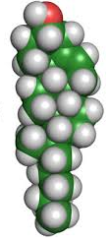
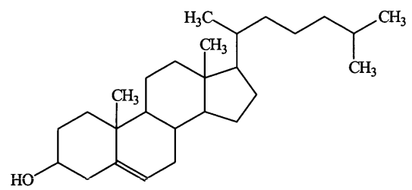
Cholesterol
A 4-ringed molecule whose chemical structure is entirely hydrophobic except for a hydroxyl (–OH) group at the end of the molecule, which may extend out from the membrane interior
Cholesterol is a fundamental component of cell membranes
Starting point for biosynthesis of steroid hormones

Slide 23
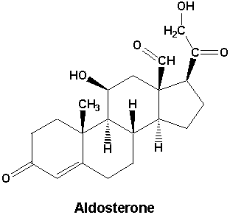
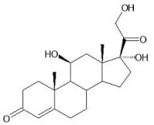
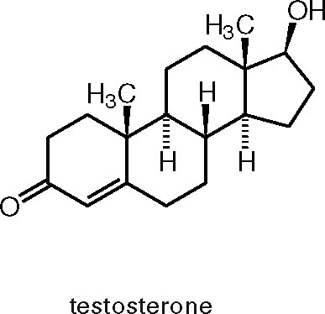
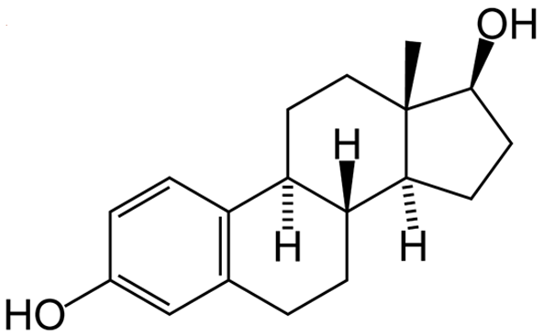
Steroids
Many of these structures differ by only one functional group or atom or slight arrangement of atoms. For example, cortisol and aldosterone differ in two ways structurally
But this difference has a large effect physiologically: cortisol regulates glucose metabolism and aldosterone regulates electrolyte balance
cortisol
estrogen

Slide 24
Lipid Transport In Blood
Because "gobs of grease" do not mix with water in blood plasma, the body has a system for transporting lipids called lipoproteins
Lipoproteins appear as 5 types:
Chylomicrons
Very Low-Density Lipoproteins (VLDLs)
Intermediate-Density Lipoprotein (IDLs)
Low-Density Lipoprotein (LDLs)
High-Density Lipoprotein Cholesterol (HDLs)
Note that in the past, they used to put "cholesterol" after the name: low-density lipoprotein cholesterol, and abbreviate it LDL. That's why it things are called "good" and "bad" cholestrol

Slide 25
Apolipoproteins
The protein part of the lipoproteins are referred to as apolipoproteins
The "apo" means that the protein is not assembled or bonded to other things that make it totally function or which identify it
Apolipoprotein AI & AII
these protein are associated with HDL in support of its function
Apolipoprotein B
this protein is associated with all lipoprotein forms except HDL
It binds to cells with LDL receptors

Slide 26
Apolipoproteins
Apolipoprotein C
The protein moves to HDL when it has been a long time between meals and to chylomicrons and VLDL after a fatty meal
Apolipoprotein E
Associates with chylomicrons and IDL
Very important in cholesterol regulation: mutations can cause hypocholesterolemia
Presence of an E4 variant indicates a high risk for Alzheimer's disease
Apolipoprotein (a)
when part of LDL (bonded to ApoB), there is an abnormal metabolism of fats causing severe atherosclerosis

Slide 27
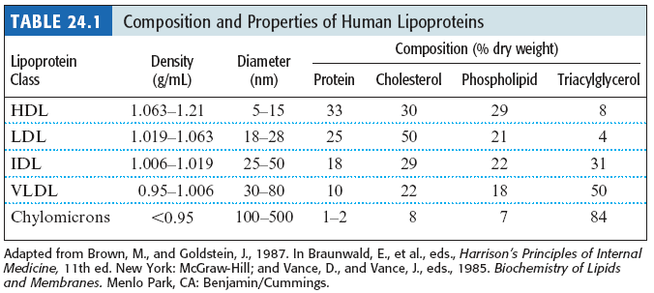
Density?
Oil/fat floats on water: therefore it has a lower density than water
When the amount of fat/lipid that makes up something increases, it lowers the density of that substance
So the lower the of density a ball of cholesterol, fat, and protein, the more fat/lipid it has
Look at the table below to see the relationship between lower density forms of lipoprotein and their lipid content

Slide 28
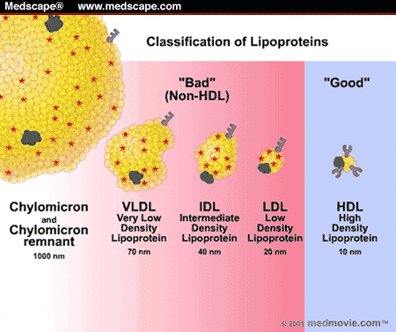

Slide 29
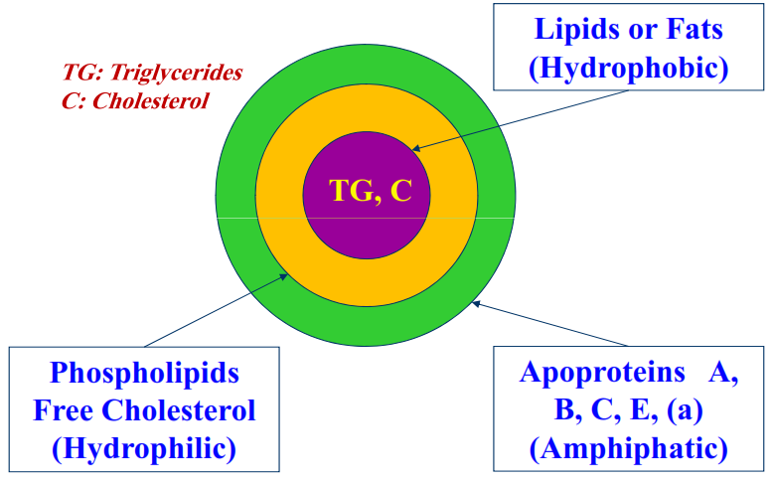
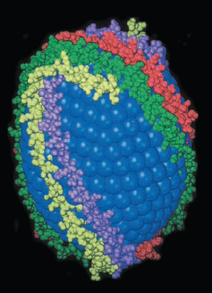
Lipoprotein Structure
There are 3 layers to the spheroid that makes up lipoproteins
Innermost layer are the most lipophilic molecules: triglycerides and esterified cholesterol
Middle: Phospholipids and unesterified cholesterol, lipophilic parts oriented inward
Outermost layer are the proteins that contain the ball, and help it to be targeted to the right tissues in transport
The bottom figure at right shows how the protein part (multi-colored) wraps around the middle layer

Slide 30
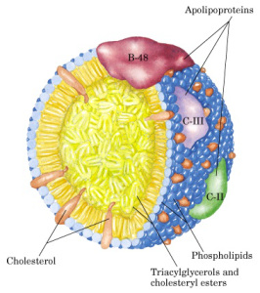
Chylomicrons
These transport triglycerides after absorption in mucosa to the liver
The liver will process these into VLDL

Slide 31
VLDL
Made in the liver and exported from it, these travel in the blood
During passage through the blood, the enzyme lipoprotein lipase on the surface of some cells removes fat (TGs) and cholesterol esters (along with some lipoproteins
The VLDL particles become LDL by this process of trimming fat off VLDL

Slide 32
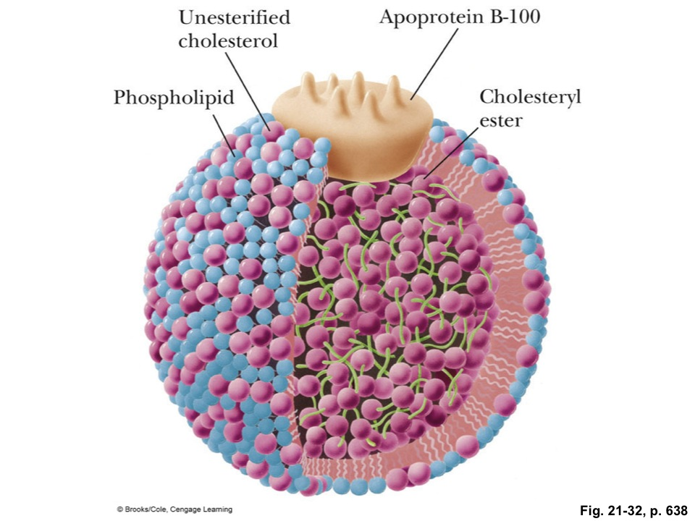
LDL
LDL is made in the liver from chylomicron processing and exported for capture by body cells
A receptor (the LDL receptor) must be on the surface of the cells for LDL to be imported into the cell
Adipose tissue cells have lots of LDL receptors

Slide 33
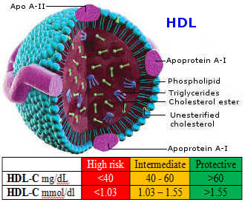
HDL
HDL is synthesized in liver and intestine
It plays a role in transporting cholesterol to the steroid-producing organs (gonads, adrenal cortex)
More importantly, HDL collects excess lipids (TGs, cholesterol) from cells and the blood and transports them to the liver, where the liver excretes the excess into the bile
http://healthy-ojas.com/assets/chol/HDL.jpg

Slide 34
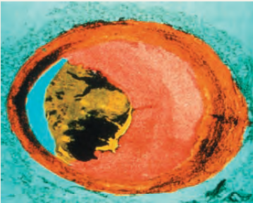
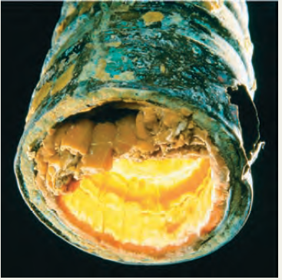
Atherosclerosis
Atherosclerosis ("hardening of the arteries") is a cardiovascular disease that involves formation of a atheroma (plaque) in the walls of blood vessels
Build up can block coronary blood flow to the heart (heart attack) or other places (ischemia), or plaques get loose and travel to brain blood vessels, causing a stroke
Which is the clogged drain/waste pipe from a sink, and which is the clogged artery?

Slide 35
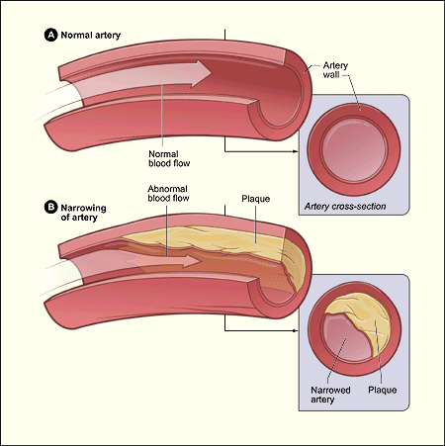

Slide 36
How It Works
Endothelial cells (they line the blood vessel wall) get "injured"
A bunch of repair cells along with immune cells come to the injury site. Immune cells tend to take the "burn it all down" approach (often how they work), releasing harsh chemicals (peroxides usually)
These peroxides react with everything, and especially LDL that is passing by constantly
So LDL gets oxidized and becomes abnormal
Its altered chemical state can cause it to adhere to the blood vessel wall
You can see where I'm going with the rest of this, right? This is called the injury hypothesis, by the way

Slide 37
Risking Atherosclerosis
The risk of clogged arteries should be higher for those with higher levels of circulating LDL
Diet and lifestyle have an effect on those circulating LDL levels
If the diet is too high in fats (and saturated generally considered more "evil"), one risks that higher LDL level
If one is too sedentary and not physically active or engaging in fitness activities, that too increases the risk of higher LDL levels
To some degree, genetics also has something to say

Slide 38
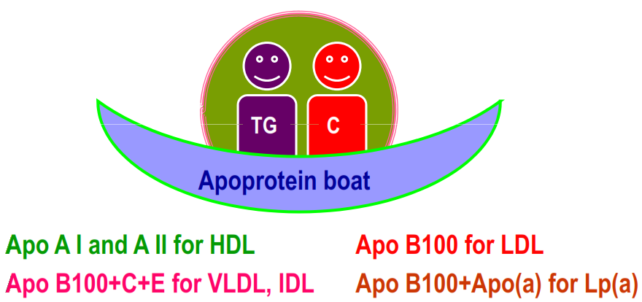

Slide 39
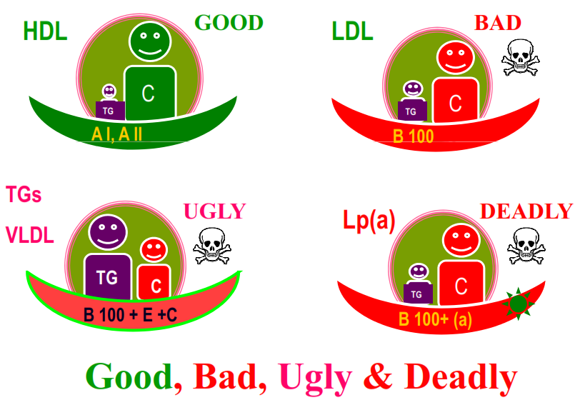

Slide 40
Reading (Sources)
Marieb: Chapter 2: pp 45-49
Becker's WotC: Chapter 3: pp 66-70
Raven: Chap 3.5

